Slide 1
Concurrence and parallelism
Ivan roa, august 2018

Slide 2
agenda
Challenge context
UML class Diagram solution
Java solution
Javadoc
Pool object capacity
DEMO

Slide 3
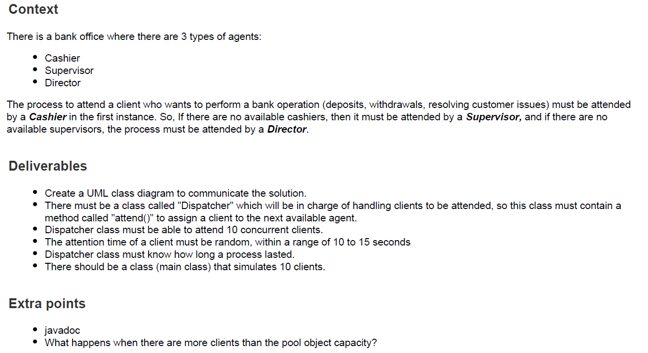
Challenge context

Slide 4
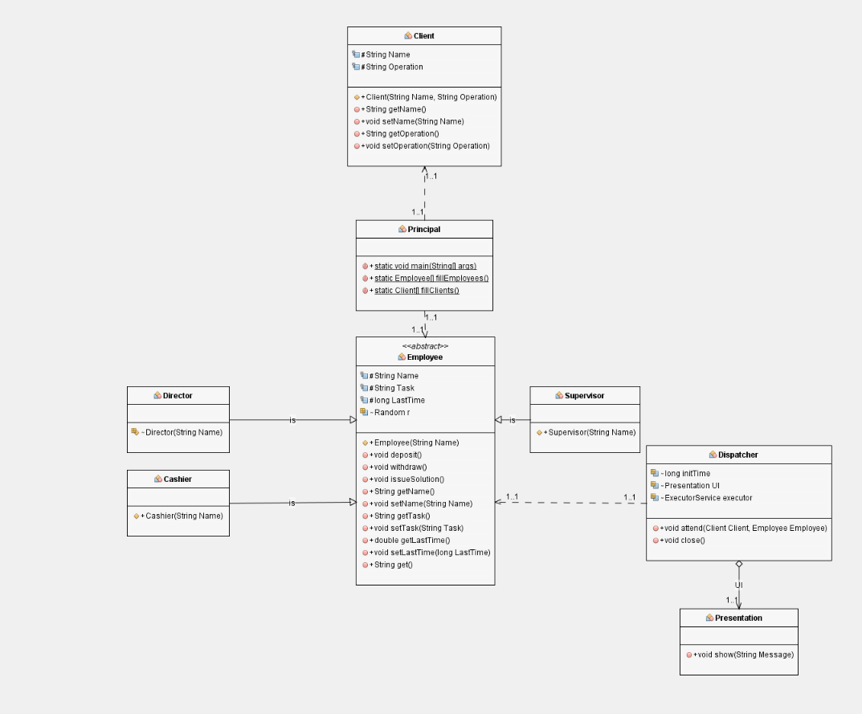
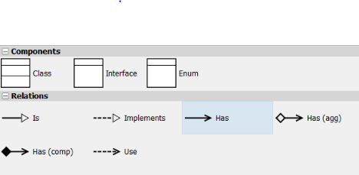
Uml class diagram

Slide 5
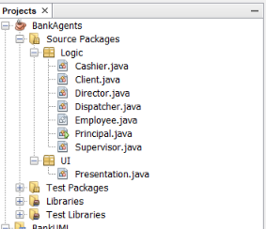
Java solution
PACKAGES

Slide 6
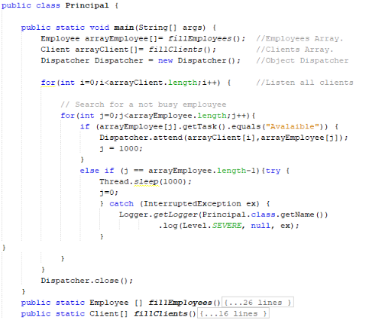
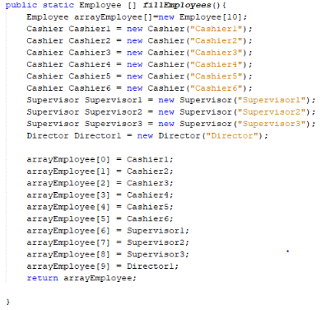
Java solution
PRINCIPAL CLASS

Slide 7
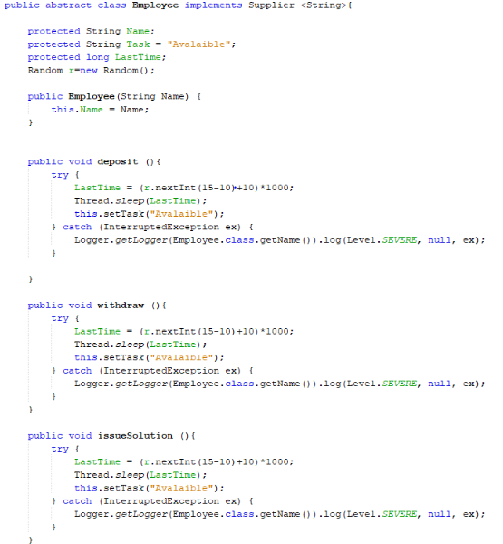
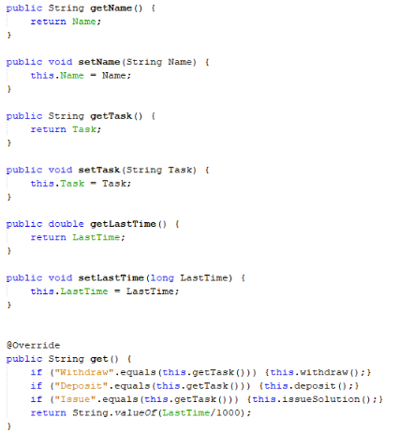
Java solution
EMPLOYEE CLASS

Slide 8
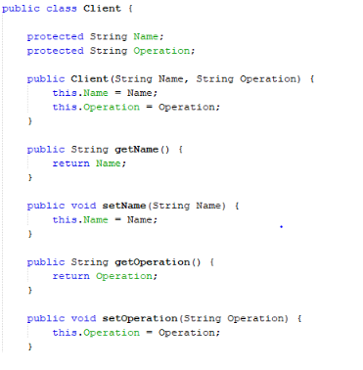
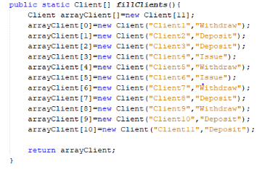
Java solution
CLIENT CLASS
Fillclients() in Principal Class

Slide 9
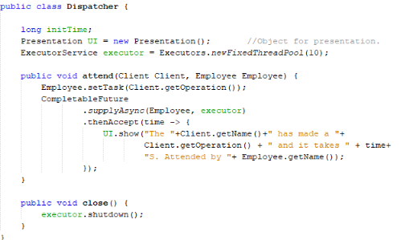
Java solution
DISPATCHER CLASS

Slide 10
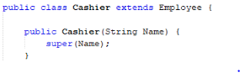
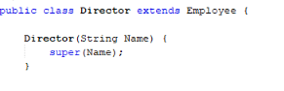
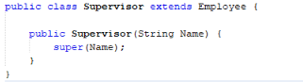
Java solution
CASHIER, DIRECTOR & SUPERVISOR

Slide 11
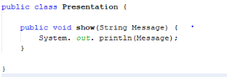
Java solution
PRESENTATION CLASS

Slide 12
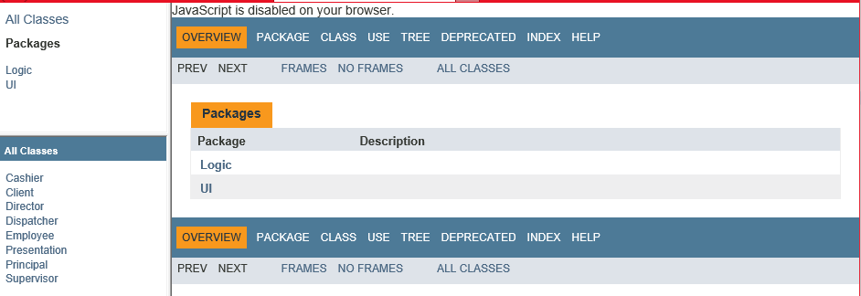
JAVADOC SOLUTION
JAVADOC

Slide 13
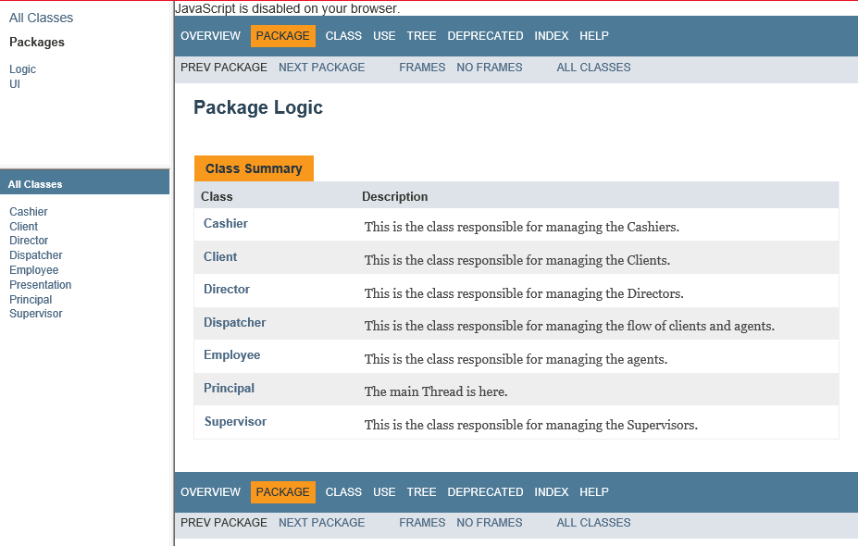
JAVADOC SOLUTION
JAVADOC

Slide 14
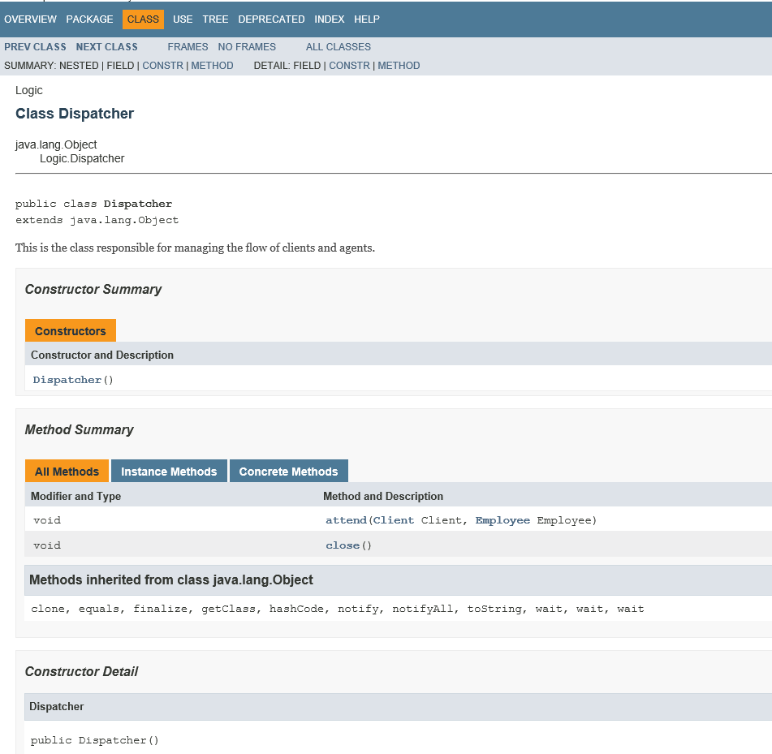
JAVADOC SOLUTION

Slide 15
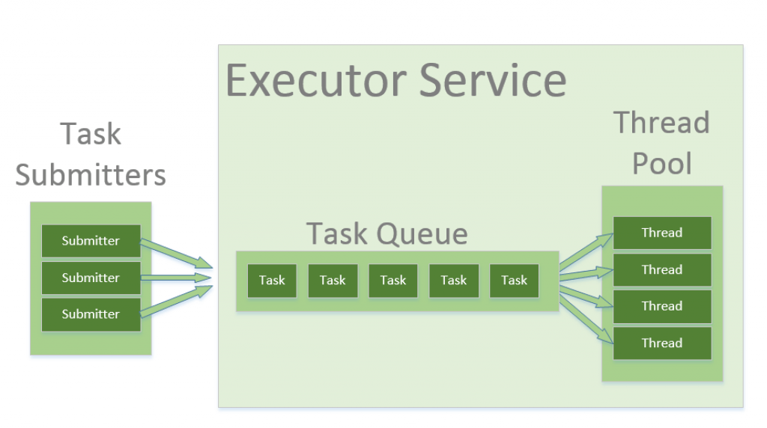
POOL object capacity
JAVA EXECUTOR SERVICE

Slide 16
DEMO TIME!
JEISON IVAN ROA MOA
AM INTERN
+57 3115517290
Jeison.roa@endava.com

